Slide 1

Research Navigation System: Capabilities & Workflow Overview
A high-level view of how the system helps researchers explore scientific domains.

Slide 2
Executive Summary
The system accelerates understanding of scientific domains through structured literature exploration
It builds and analysed citation networks starting from seed papers and keywords/expressions
It organizes and analyses the literature to help researchers quickly understand a scientific domain.
It exports everything into an Obsidian vault for transparent, AI-supported research workflows

Slide 3

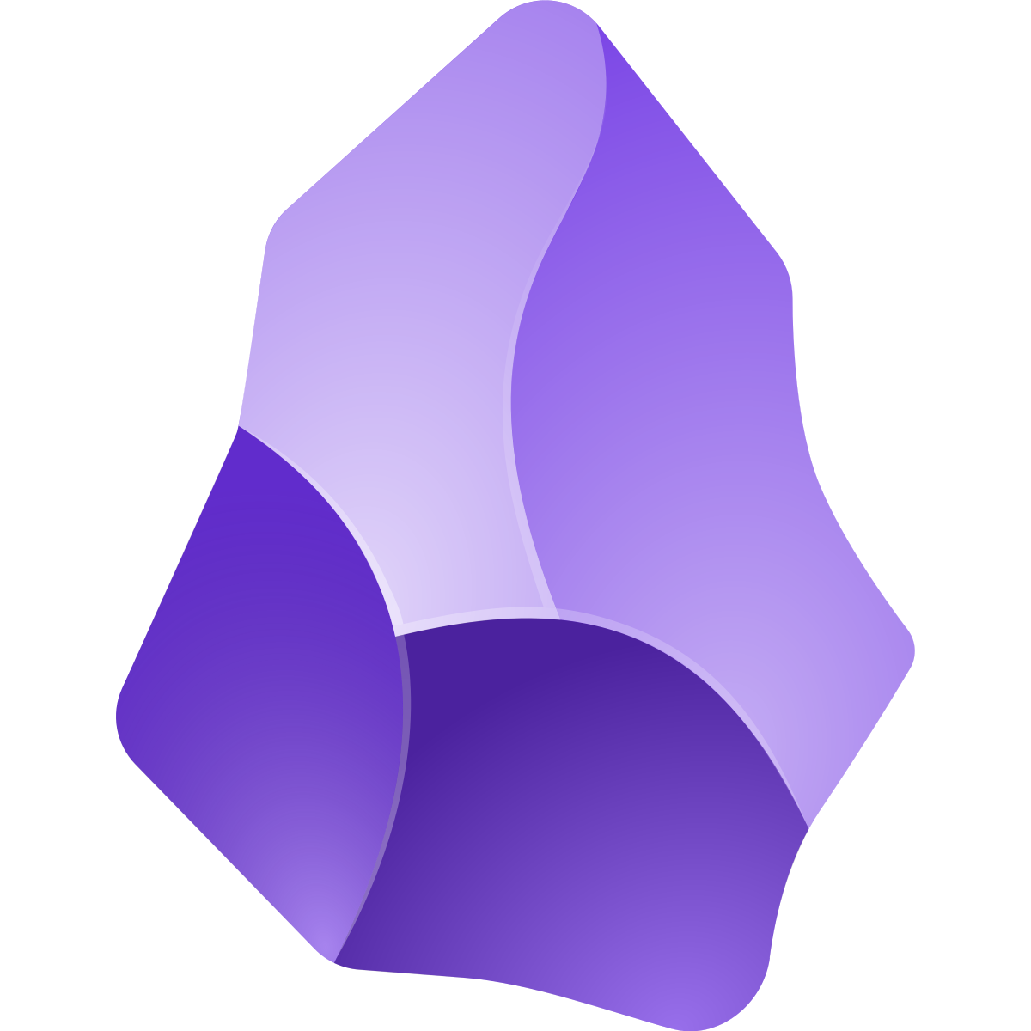
High-Level System Capabilities
Crawling and expanding literature networks from a small subset of seed papers and keywords
Ingesting papers from various sources (PDFs, Zotero libraries)
Enriching metadata to fill gaps
Ranking and filtering papers based on relevance, centrality and recency
Detecting unreliable papers via Retraction Watch checks
Summarizing and structuring in the field (Topics, major venues, key experts)
Exporting results into an Obsidian vault for integration with AI tools
Build Library
from Scratch
Build from
Zotero
Build from
PDF Folder
🛡 Retraction Watch – Safety Layer
Obsidian Vault
🤖 AI Engine
👤
📝 Notes

Slide 4
Why these choices matter
Obsidian vault exports give researchers a transparent, navigable, friendly environment.
Obsidian vault integrates nicely with GenAI enabling researchers to combine automated analysis with human oversight.
Retraction Watch integration provides scientific reliability, by avoiding unreliable content
NLP support (topic modelling, clustering) helps researchers quickly understand large fields

Slide 5
User Workflow / Experience
User 1 – Explore outward from small set of papers
Starts with one or a few key papers
System automatically finds related papers and expands the literature network
User 2 – Local papers everywhere
Has PDFs scattered across folders and device
The system gathers them into one clean, organized library
User 3 – Zotero researcher
Keeps everything in Zotero
The system builds a structured research library from any selected collection
User 4 – Hybrid collector
Uses both Zotero and local files
The system merges both sources into one unified library
User 5– Notes taker
Wants papers and notes connected in one place
The system creates an Obsidian vault where each paper has its own note page
User 6 – Needs topic overview
Has many papers but no sense of structure
The system groups them into clear topics and themes automatically
User 7 – Cares about reliability
Wants to avoid low-quality or retracted research
The system highlights retractions.

Slide 6
Comparative Analysis
Where are GenAI tools strong
Summarizing individual papers
Useful to interpret research when it’s already collected
Helpful for explanations
What our system adds
Structured workflow from ingest → filtering → clustering → synthesis
Citation-based expansion from seed papers, not keyword guessing
Reliability checks (retractions, suspicious venues, metadata gaps)
Unified research environment (Obsidian vault) that AI tools can build on top of
Hybrid approach: humans curate, AI helps with reasoning and synthesis

Slide 7

Interview
We Would Value Your Input
  We would love to get your feedback on how this workflow and research environment fit with your needs.
What We’d Like to Learn
  Which parts of the workflow feel most useful
  What could be improved or simplified
  How you typically search, organize, and analyze literature
  Any features or capabilities that would help your research
Why Your Perspective Matters
  Your perspective can help us shape the workflow to better support different types of research practices and prioritize what truly matters to users
If you’re open to it, we’d appreciate a short 20–30 minute conversation at your convenience.

Slide 8
Appendix

Slide 9
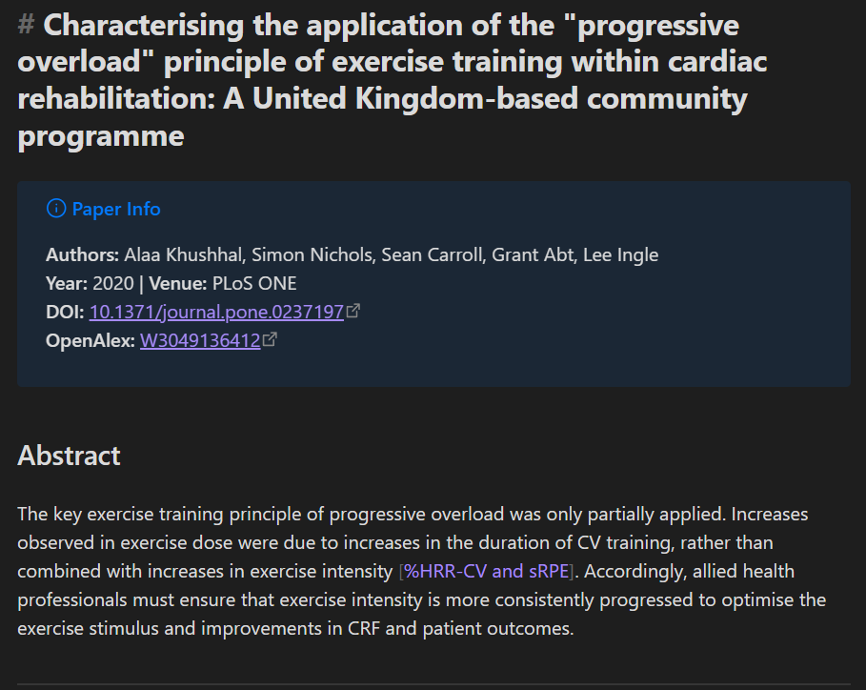
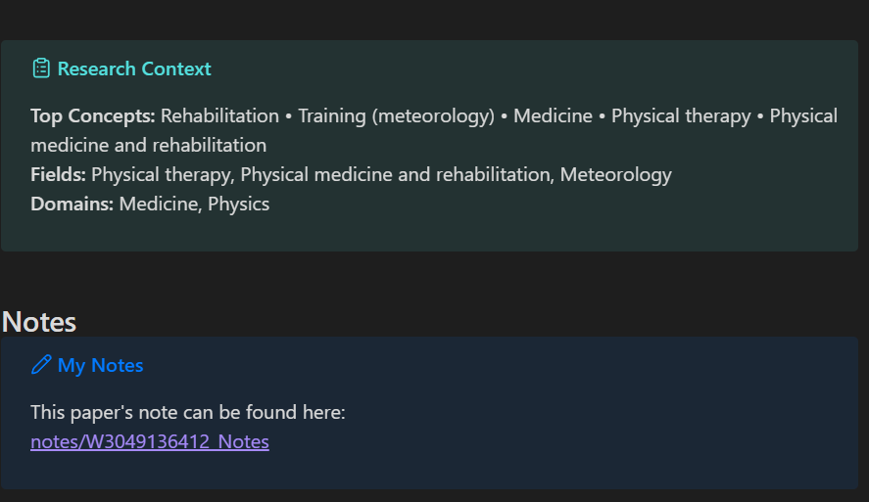
Obsidian integration
The system exports the final structured literature collection directly into an Obsidian vault.
How the system uses Obsidian
The system exports the final structured literature
collection directly into an Obsidian vault.
Each paper becomes a Markdown file with their metadata
The vault includes:
  Organized subfolders
  Topic modelling figures
  Summaries (top venues, top authors, forbidden papers, influential papers)
This provides a navigable, human-readable knowledge base
https://obsidian.md

Slide 10
Retraction Watch Integration
How the system checks paper reliability
Every paper discovered by the crawler is checked against the Retraction Watch database.
Any matches are:
  Marked as retracted
  Excluded from the high-quality network
Why this matters
Ensures the literature graph is trustworthy
Helps avoid paper-mill content (became more common in 2020–2022)
Protects researchers from building on unreliable or fraudulent work
https://retractionwatch.com

Slide 11
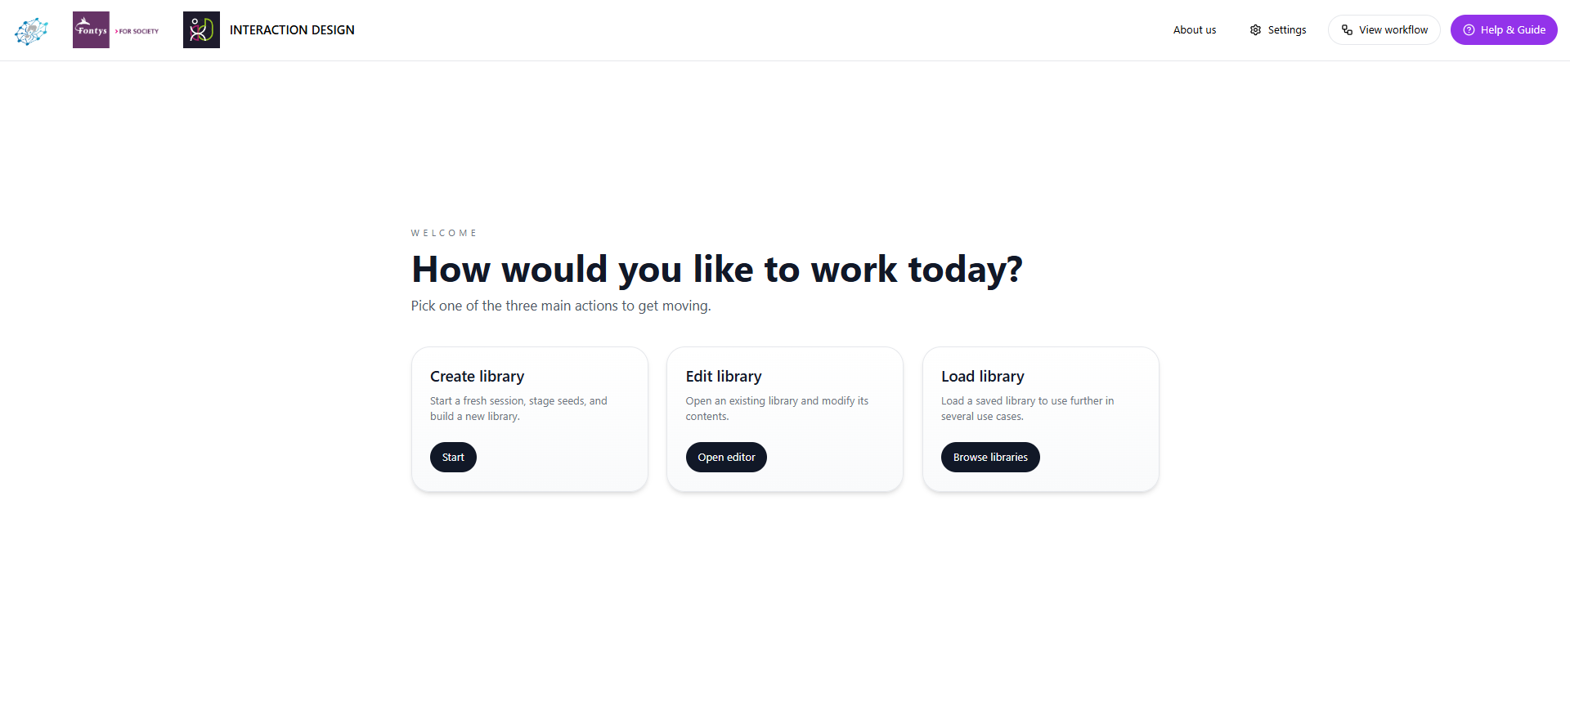
Main screen
Choose how to start

Slide 12
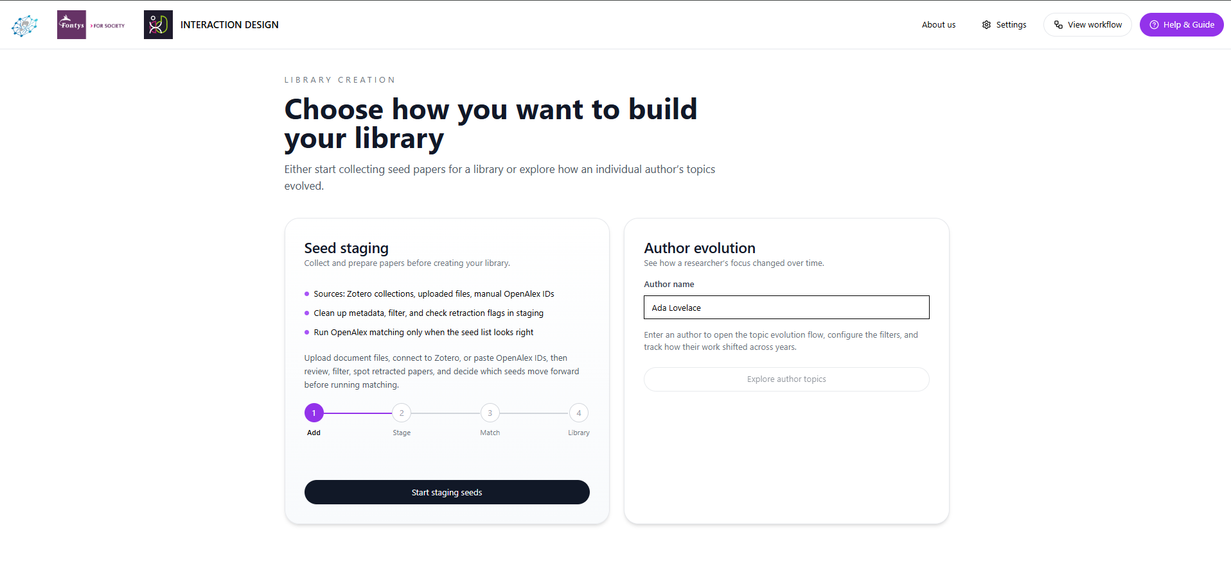
Choose a library type
Create a library from your own selected seeds or an specific authors papers

Slide 13
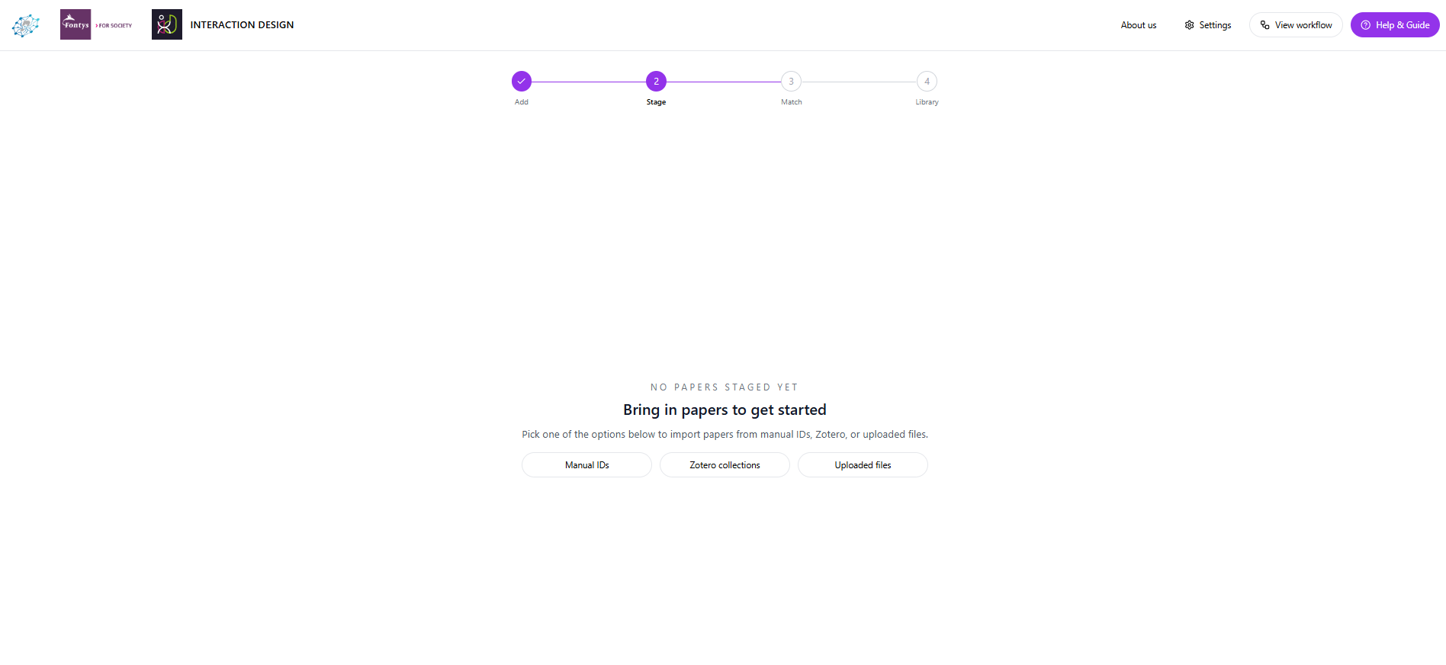
Importing papers
Import seed papers from various sources researches use

Slide 14
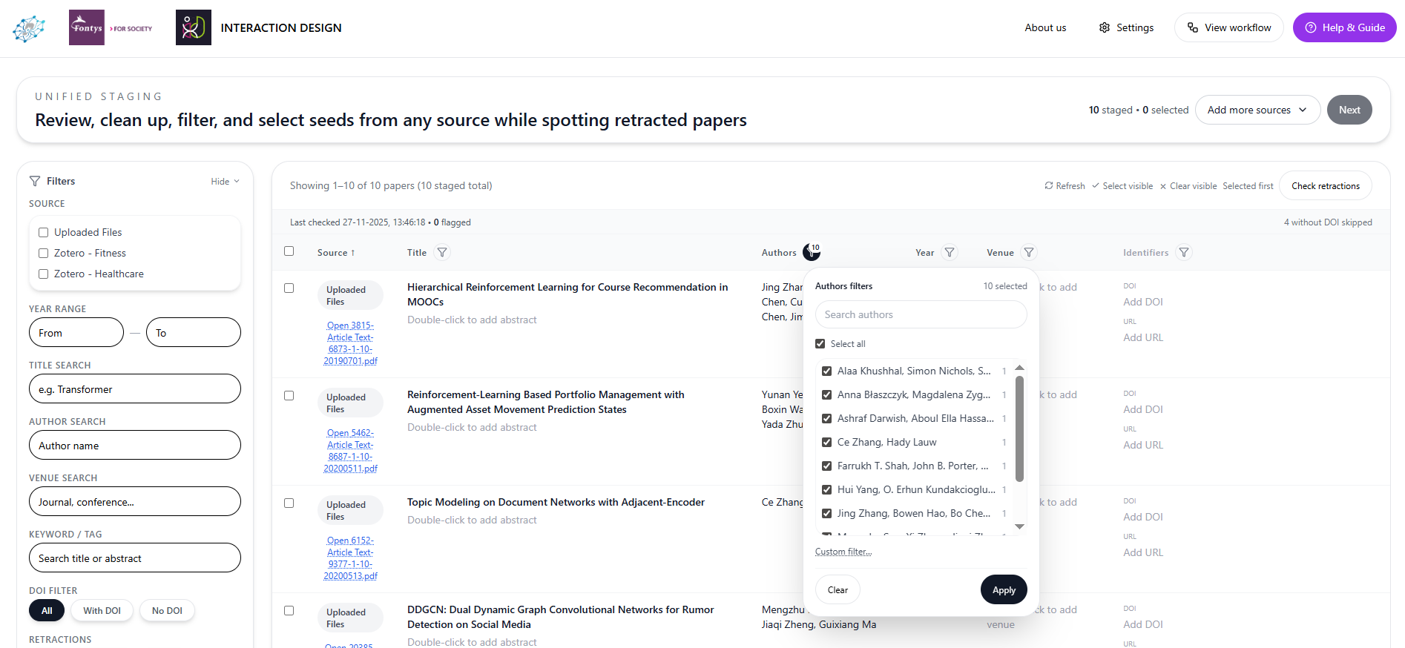
Selecting your desired papers
Filtering through the papers to find the ones you want to use and edit metadata if it’s
missing or incorrect for a paper you want to use, scan for retracted papers to avoid

Slide 15
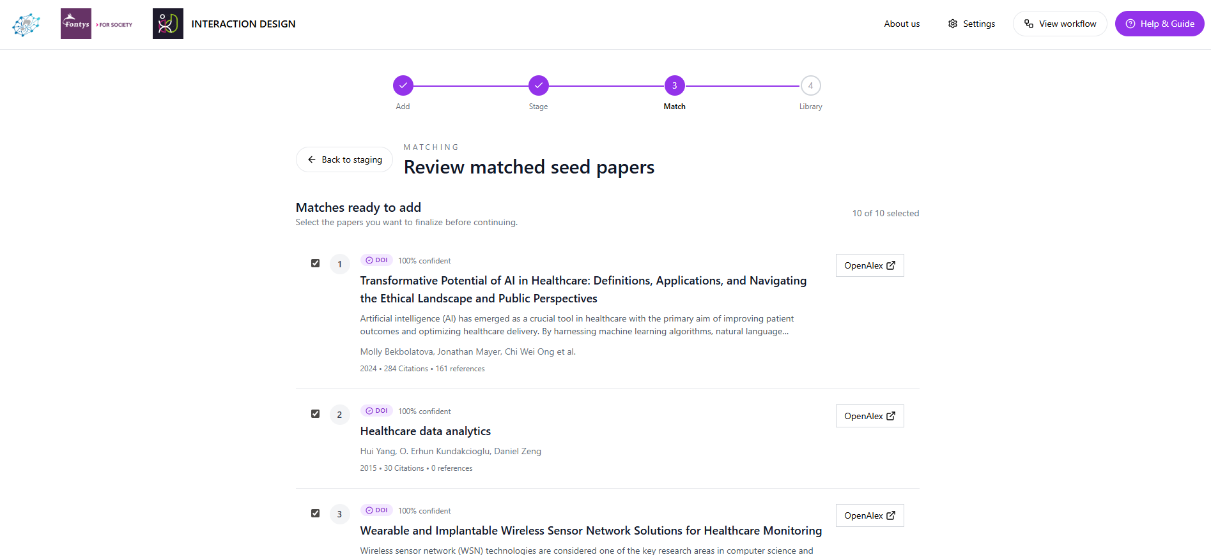
Match selected papers with OpenAlex
Matching the papers against openAlex to provide full metadata,
Making it usable for the crawler

Slide 16
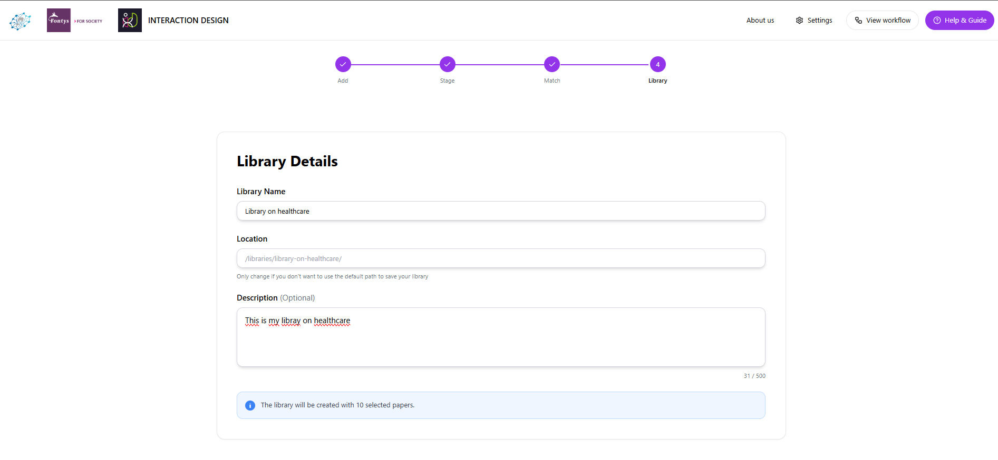
Finalizing the library
Finalize creating the library by giving it a name, and optionally a custom location and
description

